Slide 1


Lecture #22
Stacks and Queues

Slide 2
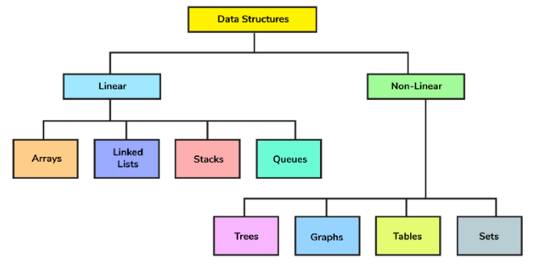
STACKS
Stacks

Slide 3
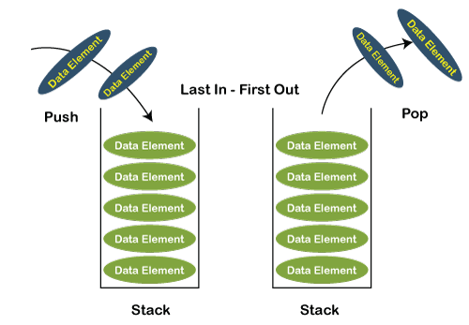

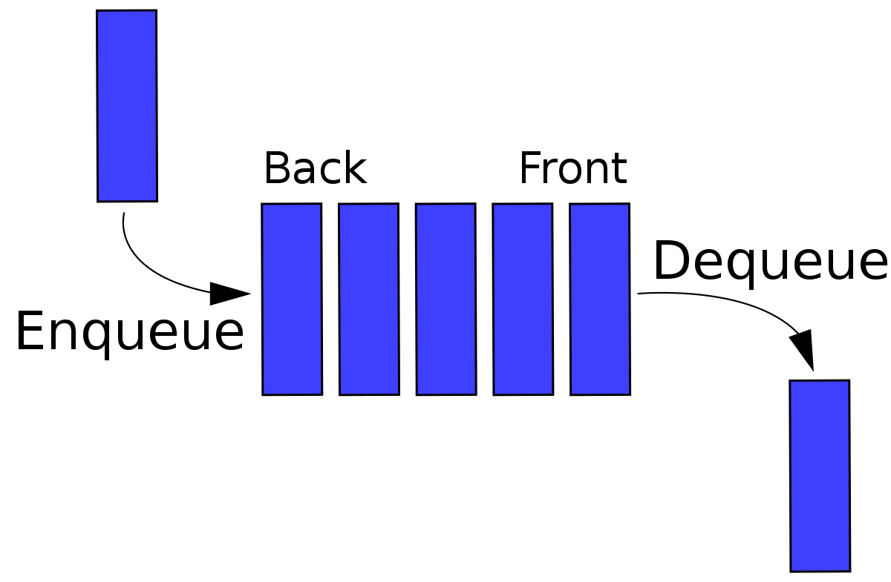
Introduction to Stack and Queue
The stack and queue are popular linear data structures with a wide variety of applications. The stack follows LIFO (Last In First Out) principle where the data is inserted and extracted from the same side. On the other hand, the queue follows FIFO (First In First Out) principle, i.e., data is inserted at one side and extracted from the other side.

Slide 4
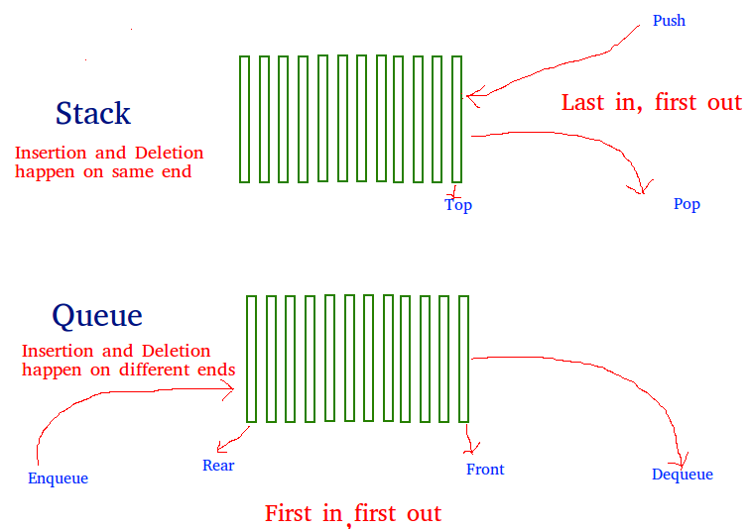
Face

Slide 5
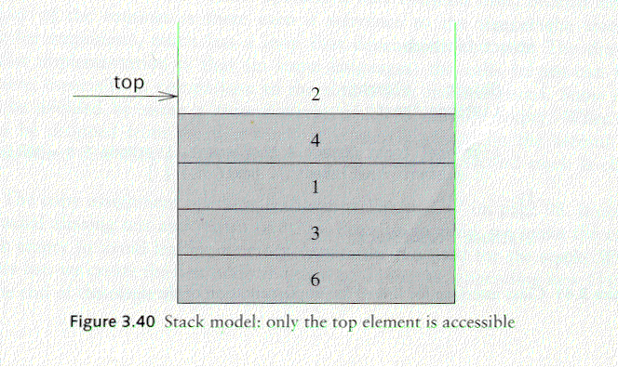
Stack Overview
Stack: A Stack is a list of elements in which an element may be inserted or deleted only at one end called the top of the stack Lists( LIFO (Last In, First Out) )
Basic operations of stack
“Push” is the term used to insert an element into a stack.
“Pop” is the term used to delete an element from stack. etc.
empty stack
push an element
push another
pop
top
B
top
top
top
A
A
A

Slide 6
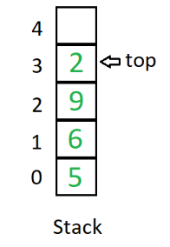
Difference between Stack and Queue Data Structures
Stack:
A stack is a linear data structure in which elements can be inserted and deleted only from one side of the list, called the top. A stack follows the LIFO (Last In First Out) principle, i.e., the element inserted at the last is the first element to come out. The insertion of an element into the stack is called push operation, and the deletion of an element from the stack is called pop operation. In stack, we always keep track of the last element present in the list with a pointer called top.

Slide 7
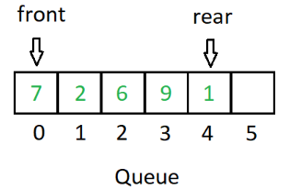
Queue
Queue is a linear data structure in which elements can be inserted only from one side of the list called rear, and the elements can be deleted only from the other side called the front.
The queue data structure follows the FIFO (First In First Out) principle, i.e. the element inserted at first in the list, is the first element to be removed from the list. The insertion of an element in a queue is called an enqueue operation and the deletion of an element is called a dequeue operation.
In queue, we always maintain two pointers, one pointing to the element which was inserted at the first and still present in the list with the front pointer and the second pointer pointing to the element inserted at the last with the rear pointer.
Face

Slide 8
Stack | Queue
A stack is a data structure that stores a collection of elements, with operations to push (add) and pop (remove) elements from the top of the stack. | A queue is a data structure that stores a collection of elements, with operations to enqueue (add) elements at the back of the queue, and dequeue (remove) elements from the front of the queue.
Stacks are based on the LIFO principle, i.e., the element inserted at the last, is the first element to come out of the list. | Queues are based on the FIFO principle, i.e., the element inserted at the first, is the first element to come out of the list.
Stacks are often used for tasks that require backtracking, such as parsing expressions or implementing undo functionality. | Queues are often used for tasks that involve processing elements in a specific order, such as handling requests or scheduling tasks.
Insertion and deletion in stacks takes place only from one end of the list called the top. | Insertion and deletion in queues takes place from the opposite ends of the list. The insertion takes place at the rear of the list and the deletion takes place from the front of the list.
Insert operation is called push operation. Delete operation is called pop operation. | Insert operation is called enqueue operation. Delete operation is called dequeue operation.

Slide 9
Stacks | Queue
Stacks are implemented using an array or linked list data structure. | Queues are implemented using an array or linked list data structure.
In stacks we maintain only one pointer to access the list, called the top, which always points to the last element present in the list. | In queues we maintain two pointers to access the list. The front pointer always points to the first element inserted in the list and is still present, and the rear pointer always points to the last inserted element.

Slide 10
Implementation of stacks
Any list implementation could be used to implement a stack
Arrays (static: the size of stack is given initially)
Linked lists (dynamic: never become full)
Array Representation:
1 | 2 | 3 | 4 | 5 | 6 | 7 | 8
XXX | YYY | ZZZ | AAA | BBB
TOP
MAXSTK

Slide 11
Basic Operations on Stack
In order to make manipulations in a stack, there are certain operations provided to us.
push() to insert an element into the stack
pop() to remove an element from the stack
top() Returns the top element of the stack.
isEmpty() returns true if stack is empty else false.
size() returns the size of stack.

Slide 12
How to create the Stack (Using Standard Template Library - STL)
(For Introduction Only)
In order to create a stack in C++, we first need to include the stack header file.
#include <stack>
Once we import this file, we can create a stack using the following syntax:
stack<type> st; //Name of Stack
Here, type indicates the data type we want to store in the stack. For instance,
stack<int> integer_stack; // create a stack of integers
stack<string> string_stack; // create a stack of strings

Slide 13
Basic Program of Stack – 1 (Using STL)
(For Introduction Only)
#include <iostream>
#include <stack>
using namespace std;
int main() {
stack<string> str; // create a stack of strings
str.push("C++");
str.push("Java");
str.push("Python");
cout << str.top(); // print top element
cout<<str.size(); // Display size of stack
str.pop(); //Delete from Stack
cout << str.top(); //New Top of Stack
cout<<str.size(); // New Size of Stack
return 0;
}
Output:
Python 3
Java 2

Slide 14
Basic Program of Stack – 2 (Using STL)
(For Introduction Only)
#include <iostream>
#include <stack>
using namespace std;
void displayStack(stack <int> ss)
{
stack <int> sg = ss;
while (!sg.empty())
{
cout << '\t' << sg.top();
sg.pop();
}
cout << '\n';
}
int main ()
{
stack <int> newst;
newst.push(55);
newst.push(44);
newst.push(33);
newst.push(22);
newst.push(11);
cout << "The stack newst is : ";
displayStack(newst);
cout << "\n newst.size() : " << newst.size();
cout << "\n newst.top() : " << newst.top();
cout << "\n newst.pop() : ";
newst.pop();
displayStack(newst);
return 0;
}
Output:
The stack newst is : 11 22 33 44 55
newst.size() : 5
newst.top() : 11
newst.pop() : 22 33 44 55

Slide 15
Algorithm for PUSH operation:
1. Check if the stack is full or not.
2. If the stack is full, then print error of overflow and exit the program.
3. If the stack is not full, then increment the top and add the element.
Algorithm for POP operation:
1. Check if the stack is empty or not.
2. If the stack is empty, then print error of underflow and exit the program.
3. If the stack is not empty, then print the element at the top and decrement the top.

Slide 16
Stack Program using Arrays:
#include <iostream>
using namespace std;
int stack[100], n=100, top=-1;
void push(int val) {
if(top>=n-1)
cout<<"Stack Overflow"<<endl;
else {
top++;
stack[top]=val;
}
}
void pop() {
if(top<=-1)
cout<<"Stack Underflow"<<endl;
else {
cout<<"The popped element is "<< stack[top] <<endl;
top--;
}
}
void display() {
if(top>=0) {
cout<<"Stack elements are:";
for(int i=top; i>=0; i--)
cout<<stack[i]<<" ";
cout<<endl;
} else
cout<<"Stack is empty";
}

Slide 17
Stack Program using Arrays:
int main() {
int ch, val;
cout<<"1) Push in stack"<<endl;
cout<<"2) Pop from stack"<<endl;
cout<<"3) Display stack"<<endl;
cout<<"4) Exit"<<endl;
do {
cout<<"Enter choice: "<<endl;
cin>>ch;
switch(ch) {
case 1: {
cout<<"Enter value to be pushed:"<<endl;
cin>>val;
push(val);
break;
}
case 2: {
pop();
break;
}
case 3: {
display();
break;
}
case 4: {
cout<<"Exit"<<endl;
break;
}
default: {
cout<<"Invalid Choice"<<endl;
}
}
}while(ch!=4);
return 0;
}

Slide 18
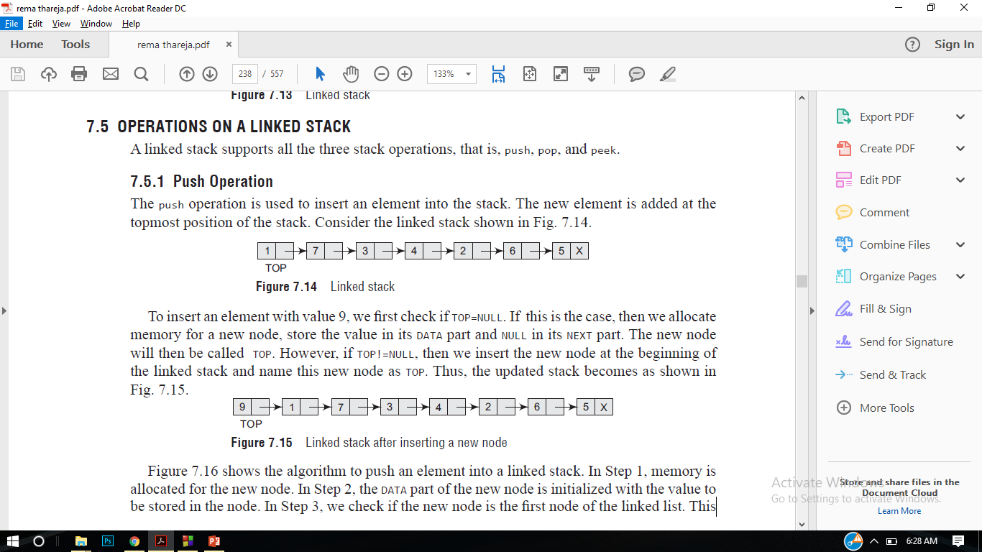
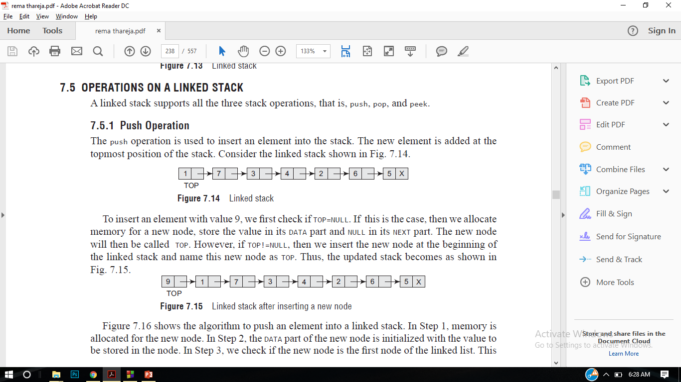
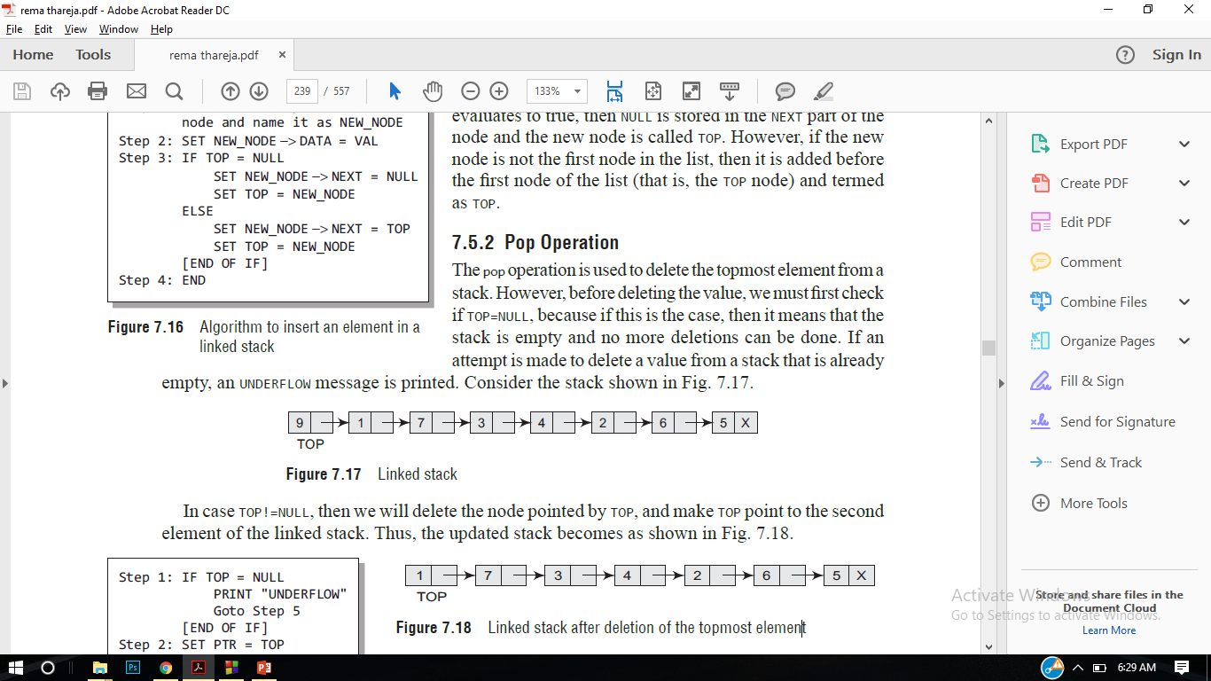
Linked List Implementation of Stack

Slide 19
Stack Program using Linked List:
#include <iostream>
using namespace std;
class Node {
public:
int data;
Node *next;
Node(int val) // Parameterised Constructor
{
data = val;
next = NULL;
}
};
class Stack
{
Node *top;
public:
Stack() // Default Constructor
{
top = NULL;
}
void push(int);
void printStack();
void pop();
};
void Stack::push(int data)
{
// Create the new Node.
Node *newNode = new Node(data);
newNode->data = data;
newNode->next = top;
top = newNode;
}
void Stack::printStack()
{
Node* ptr;
if(top==NULL)
cout<<"stack is empty";
else {
ptr = top;
cout<<"Stack elements are: ";
while (ptr != NULL) {
cout<< ptr->data <<" ";
ptr = ptr->next;
}
}
cout<<endl;
}

Slide 20
void Stack::pop() {
if(top==NULL)
cout<<"Stack Underflow"<<endl;
else {
cout<<"The popped element is “
cout<< top->data <<endl;
top = top->next;
}
}
int main()
{
Stack s;
int ch, val;
cout<<"1) Push in stack"<<endl;
cout<<"2) Pop from stack"<<endl;
cout<<"3) Display stack"<<endl;
cout<<"4) Exit"<<endl;
do {
cout<<"Enter choice: "<<endl;
cin>>ch;
switch(ch) {
case 1: {
cout<<"Enter value to be pushed:"<<endl;
cin>>val;
s.push(val);
break;
}
case 2: {
s.pop();
break;
}
case 3: {
s.printStack();
break;
}
case 4: {
cout<<"Exit"<<endl;
break;
}
default: {
cout<<"Invalid Choice"<<endl;
}
}
}while(ch!=4);
return 0;
}

Slide 21
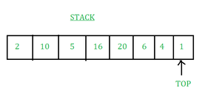
What is meant by Top of the Stack?
When a new element is added to the stack, it is placed on top of the existing elements. Similarly, when an element is removed from the stack, the topmost element is removed first. The top of the stack is always the element that is currently accessible for viewing or manipulation.
The pointer through which the elements are accessed, inserted, and deleted in the stack is called the top of the stack. It is the pointer to the topmost element of the stack.

Slide 22
Application of Stack Data Structure:
Function calls and recursion: When a function is called, the current state of the program is pushed onto the stack. When the function returns, the state is popped from the stack to resume the previous function’s execution.
Undo/Redo operations: The undo-redo feature in various applications uses stacks to keep track of the previous actions. Each time an action is performed, it is pushed onto the stack. To undo the action, the top element of the stack is popped, and the reverse operation is performed.
Expression evaluation: Stack data structure is used to evaluate expressions in infix, postfix, and prefix notations. Operators and operands are pushed onto the stack, and operations are performed based on the stack’s top elements.
Browser history: Web browsers use stacks to keep track of the web pages you visit. Each time you visit a new page, the URL is pushed onto the stack, and when you hit the back button, the previous URL is popped from the stack.
Backtracking Algorithms: The backtracking algorithm uses stacks to keep track of the states of the problem-solving process. The current state is pushed onto the stack, and when the algorithm backtracks, the previous state is popped from the stack.

Slide 23
Application of Stack in real life:
CD/DVD stand.
Stack of books in a book shop.
Call center systems.
Undo and Redo mechanism in text editors.
The history of a web browser is stored in the form of a stack.
Call logs, E-mails, and Google photos in any gallery are also stored in form of a stack.
YouTube downloads and Notifications are also shown in LIFO format(the latest appears first ).

Slide 24
Advantages of Stack:
Easy implementation: Stack data structure is easy to implement using arrays or linked lists, and its operations are simple to understand and implement.
Efficient memory utilization: Stack uses a contiguous block of memory, making it more efficient in memory utilization as compared to other data structures.
Fast access time: Stack data structure provides fast access time for adding and removing elements as the elements are added and removed from the top of the stack.
Helps in function calls: Stack data structure is used to store function calls and their states, which helps in the efficient implementation of recursive function calls.
Supports backtracking: Stack data structure supports backtracking algorithms, which are used in problem-solving to explore all possible solutions by storing the previous states.
Used in Compiler Design: Stack data structure is used in compiler design for parsing and syntax analysis of programming languages.
Enables undo/redo operations: Stack data structure is used to enable undo and redo operations in various applications like text editors, graphic design tools, and software development environments.

Slide 25
Disadvantages of Stack:
Limited capacity: Stack data structure has a limited capacity as it can only hold a fixed number of elements. If the stack becomes full, adding new elements may result in stack overflow, leading to the loss of data.
No random access: Stack data structure does not allow for random access to its elements, and it only allows for adding and removing elements from the top of the stack. To access an element in the middle of the stack, all the elements above it must be removed.
Memory management: Stack data structure uses a contiguous block of memory, which can result in memory fragmentation if elements are added and removed frequently.
Stack overflow and underflow: Stack data structure can result in stack overflow if too many elements are pushed onto the stack, and it can result in stack underflow if too many elements are popped from the stack.
Recursive function calls limitations: While stack data structure supports recursive function calls, too many recursive function calls can lead to stack overflow, resulting in the termination of the program.

Slide 26
Thank You

